Slide 1
IE 411/511:
Visual Programming for Industrial Applications
Lecture Notes #1
Course Overview
&
Introduction

Slide 2
Course Overview
Personnel
Course Objective
Course Learning Outcomes
Textbook & References
Grading Criteria
  IE 411/511
  IE 511 only
Homework
Exams
Attendance & Electronic Devices

Slide 3
Course Overview (cont.)
Lecture Format
Classroom Conduct
Challenging Grades
Academic Integrity
Tentative Schedule

Slide 4
Personnel
Instructor: Dr. J. David Porter
Office: 420 Rogers Hall
Phone: (541) 737-2446
Email: david.porter@oregonstate.edu
Office hours: M W 3:00 – 4:30 PM
  By appointment
  Do not email programming-related questions
    Lengthy or potentially difficult questions should be handled face to face with instructor or GTA
    Bring your computer so that we can look at the code
Course’s URL:
  http://classes.engr.oregonstate.edu/mime/fall2015/ie411

Slide 5
Personnel (cont.)
GTA: Myrna Leticia Cavazos
Office: 349 Batcheller Hall
Email: myrna.cavazos@oregonstate.edu
Office hours: Tuesdays and Fridays 9:00-10:00am

Slide 6
Course Objective
To prepare students with the skills to design, implement, debug and execute fully functional Visual Basic applications
To accomplish this objective, almost every lecture session will include
  Coverage of general programming concepts
  Coverage of programming concepts specific to Visual Basic
  Hands-on exercises

Slide 7
Course Learning Outcomes
All students completing IE 411 should be able to:
  Explain the differences amongst machine languages, assembly languages and high-level languages.
  Explain the concept of object-oriented design (OOD).
  Navigate through the Visual Studio Integrated Development Environment (IDE).
  Write algorithms with pseudocode to conceptualize a program during the program-design process.
  Utilize control structures such as if-then-else statements, for loops, and do-while loops.
  Write reusable code in the form of methods, sub procedures, and functions.
  Utilize arrays to group of variables (i.e., elements) containing values of the same type.

Slide 8
Course Learning Outcomes (cont.)
All students completing IE 411 should be able to:
  Utilize exception handling to improve a program’s fault tolerance.
  Develop Visual Basic applications that interact with relational databases.
  Demonstrate the ability to communicate and document technical information in a professional, structured, timely, and effective manner.

Slide 9
Course Learning Outcomes (cont.)
All students completing IE 511 should be able to meet the learning outcomes of IE 411, plus be able to:
  Create a graphical user interface (GUI) based on the user interface design process.
  Evaluate the effectiveness of a GUI based on the four Gestalt principles.

Slide 10
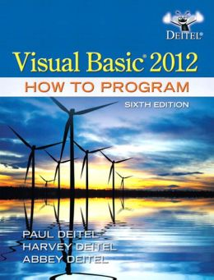
Textbook & References
Visual Basic 2012 How to Program 6th Edition
  Paul Deitel, Harvey Deitel and Abbey Deitel
Visual Basic Resources
  https://msdn.microsoft.com/en-us/vstudio/hh388573.aspx

Slide 11
Grading Criteria – IE 411/511
Homework 40%
Midterm Exam 15%
  Tuesday, November 3rd
Final Exam (Comprehensive) 15%
  Monday, December 7th @ 6:00 PM
Term Project 30%

Slide 12
Grading Criteria – IE 511 only
It is OSU policy that when a graduate course is dual-listed (i.e., “slash” course), students taking the graduate course should receive additional education and training and must be held to higher standards of performance than students taking the undergraduate course
  This university policy will be implemented in every deliverable in this course for students enrolled in IE 511

Slide 13
Homework
Homework will be assigned on a regular basis
Unless otherwise specified by the instructor, solutions to homework assignments must be submitted via The Engineering Accounts and Classes Homepage (T.E.A.C.H) by the deadline specified
  https://engr.oregonstate.edu/teach
Late assignments will not be allowed
  No exceptions

Slide 14
Exams
Exams
  Closed-book, closed-notes exams
  Based mainly on homework assignments and lecture material

Slide 15
Attendance & Electronic Devices
Attendance
  Students are responsible for the material covered during class and are expected to attend lectures regularly
  Attendance will be taken on a random basis during the term
Electronic Devices
  Set cell phones to silent mode
  No texting in class
  The use of a laptop computer must be limited to class-related activities
    No Internet browsing
    No checking email

Slide 16
Lecture Format
The first part of class will be devoted to questions
  Unreasonably long questions will be handled one on one
  If I do not know the answer, I will get it for the class by the next lecture
Lecture
  Ask questions
5 min. break
  Not meant as an exit time
End of Class
  Will try to leave time for questions
  You may as well ask

Slide 17
Lecture Format (cont.)
Material will be delivered on PowerPoint slides using a Tablet PC
  Material will be added to slides during class
  There will be periodic in-class programming sessions
  Minor changes to the slides may be made just before class
All added (hand written) material is your responsibility
  Hand written material added by instructor will NOT be available on the website

Slide 18
Classroom Conduct
Students are expected to arrive to class on time, be attentive throughout the class meeting, and stay in class until dismissed by the instructor
The following are considered examples of disruptive behavior:
  Being late, reading the paper, sleeping in class
  Making noises, repeatedly interrupting
  Passing notes, answering cell phone
  … (review syllabus for more examples)
Notify instructor when absent from class as soon as possible
  Before or after the fact
  Justifiable reason

Slide 19
Challenging Grades
Students have 72 hours (not including weekends and holidays)
  The 72-hour clock begins from the time any graded deliverable (e.g., homework assignment or an exam) is returned in class by the instructor regardless of whether or not the student was present to receive it
To challenge a grade, a student must submit a word-processed description of the grading error (attached to the graded homework assignment or exam) to the instructor
Students will be notified of the outcome of their grade challenge within 72 hours (not including weekends and holidays) of its receipt

Slide 20
Academic Integrity
I take academic integrity very seriously
  Therefore, there is a zero tolerance policy in effect for cheating in this class
All work must be the student’s own, unless collaboration is specifically and explicitly permitted
Any unauthorized collaboration or copying will at a minimum result in no credit for the affected assignment/exam and may be subject to further action as described in the Academic Dishonesty section of OSU’s Student Conduct and Community Standards (SCCS) web page
  http://oregonstate.edu/studentconduct/

Slide 21
Tentative Schedule
Week 0 & 1
  Course Introduction
  Overview of Visual Basic Studio 2012 IDE
Week 2
  Intro to Visual Basic Programming
Week 3
  Control Statements: Part 1
Week 4
  Control Statements: Part 1/Control Statements: Part 2
Week 5
  Control Statements: Part 2

Slide 22
Tentative Schedule (cont.)
Week 6
  Midterm Examination
  Methods & Exception Handling
Week 7
  Methods & Exception Handling
Week 8
  Arrays
Week 9 (Thanksgiving)
  Working with Databases
Week 10
  Working with Databases
Final Examination: Mon, Dec 7th @ 6:00 PM

Slide 23
Visual Studio Express
Need to install “Visual Studio Express 2015 for Desktop” on your laptop
  Need to bring personal laptop to all lecture sessions starting next class
Software can be downloaded from Microsoft’s web site
  https://www.visualstudio.com/en-us/products/visual-studio-express-vs.aspx

Slide 24
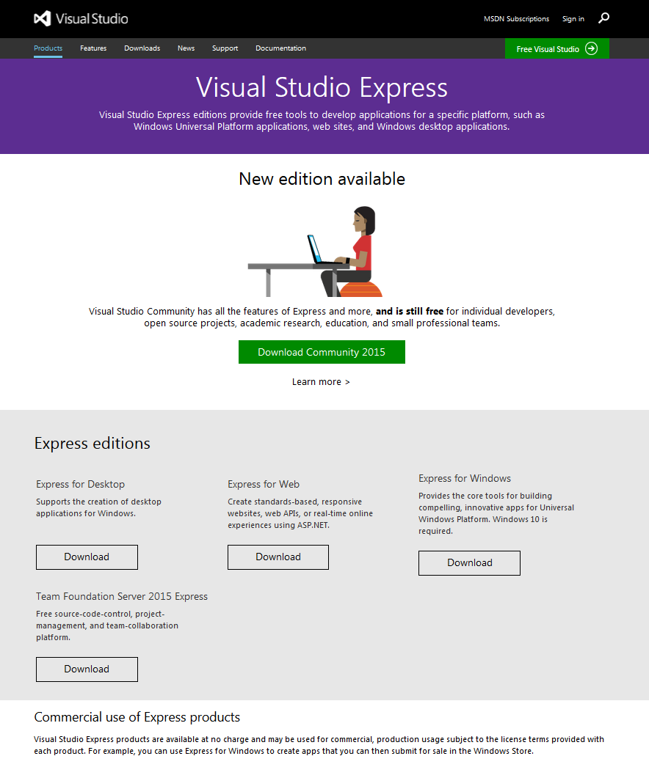
Visual Studio Express (cont.)

Slide 25
Course Introduction

Slide 26
Introduction
Computers process data under the control of sequences of instructions called computer programs
In this course, you will learn object-oriented programming
  Key programming methodology that enhances the productivity of a programmer and reduces software development costs
You will create many software objects that model both abstract and real-world things

Slide 27
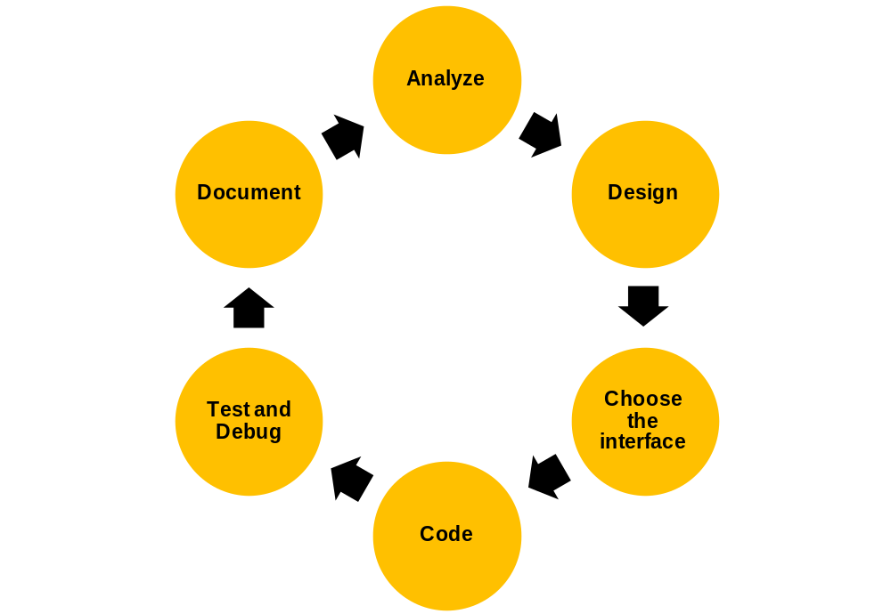
Program Development Cycle
Many programmers plan their programs using a sequence of steps referred to as the program development cycle

Slide 28
Program Development Cycle (cont.)
Detailed steps of the program development cycle
  Analyze
    Define the problem (what the output should be)
    Have a clear idea of what data (or input) are given and the relationship between the input and the desired output
  Design
    Plan the solution to the problem
    Find a logical sequence of precise steps that solve the problem
      Typically requires developing a flowchart, pseudocode or a hierarchical chart
    Use representative data to test the algorithm by hand to ensure that it is correct

Slide 29
Program Development Cycle (cont.)
  Choose the interface
    Determine how the input will be obtained (e.g., user provided, input file, etc.) and how the output will be displayed (e.g., text box)
    Create appropriate controls to allow the user to control the program
  Code
    Translate the algorithm into a programming language and enter it into the computer
  Test and debug
    Locate and remove any errors in the program
    Testing is the process of finding the errors in the program and debugging is the process of removing the errors from the program

Slide 30
Program Development Cycle (cont.)
  Complete the documentation
    Organize all the material that describes the program
    Documentation is intended to allow another person, or the programmer at a later date, to understand the program
    Also includes comments added by the programmer directly into the code

Slide 31
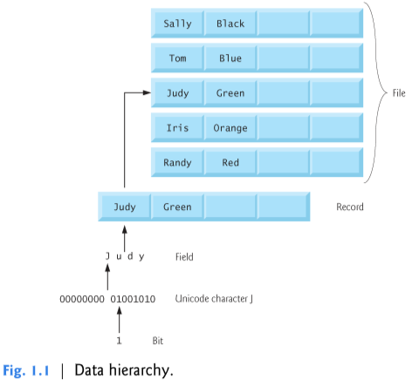
Data Hierarchy
Data items processed by computers form a data hierarchy that becomes larger and more complex in structure

Slide 32
Data Hierarchy (cont.)
Bits
The smallest data item in a computer can assume the value 0 or the value 1
Such a data item is called a bit
  Short for binary digit, i.e., a digit that can assume either of two values
Characters
Digits, letters and special symbols are known as characters
  Decimal digits (0–9), uppercase letters (A–Z), lowercase letters (a–z), and special symbols (e.g., $, @, %, &)
Visual Basic supports several character sets

Slide 33
Data Hierarchy (cont.)
Fields
A field is a group of characters or bytes that conveys meaning
  For example, the fields name or age
Records
Several related fields can be used to compose a record
  Employee ID number (a whole number)
  Name (a string of characters)
  Address (a string of characters)
  Hourly pay rate (a number with a decimal point)
  Year-to-date earnings (a number with a decimal point)

Slide 34
Data Hierarchy (cont.)
Files
A file is a group of related records
  More generally, a file contains arbitrary data in arbitrary formats
Database
A database is a collection of data that is organized for easy access and manipulation
The most popular database model is the relational database model
  Data is stored in simple tables
A table includes records composed of fields

Slide 35
Programming Languages
Programmers write instructions in various programming languages
Computer languages can be divided into three general types
  Machine languages
  Assembly languages
  High-level languages
Machine languages
Assembly languages
High-level languages

Slide 36
Machine Language
A computer can directly understand only its own machine language
Machine languages generally consist of streams of numbers
  Ultimately reduced to binary 1s and 0s
Machine language programs are nearly incomprehensible to humans
Machine language programming proved to be slow and error prone

Slide 37
Assembly Language
English-like abbreviations form the basis of assembly languages
Assemblers convert assembly language programs to machine language
Computers cannot understand assembly language code until it is translated into machine language
LOAD BASEPAY
ADD OVERPAY
STORE GROSSPAY

Slide 38
High-Level Language
To speed up the programming process, high-level languages were developed
Compilers convert high-level-language programs into machine language
High-level languages look almost like everyday English
Visual Basic is one of the world’s most popular
high-level programming languages
grossPay = basePay + overTimePay

Slide 39
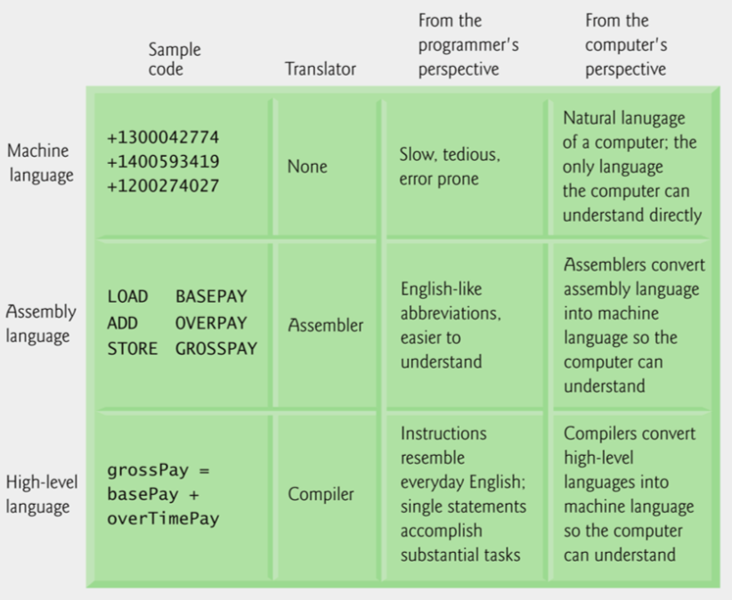
Programming Languages (cont.)
Comparing machine, assembly, and high-level languages

Slide 40
Visual Basic
Visual Basic evolved from BASIC
  Beginner’s All-purpose Symbolic Instruction Code
  Developed in the mid-1960s at Dartmouth College as a language for introducing novices to fundamental programming techniques
When Bill Gates founded Microsoft Corporation in the 1970s, he implemented BASIC on several early personal computers
In the late 1980s and the early 1990s, Microsoft developed its Windows graphical user interface (GUI)
  The visual part of the operating system with which users interact

Slide 41
Visual Basic (cont.)
With the creation of the Windows GUI, the natural evolution of BASIC was toVisual Basic
  Introduced by Microsoft in 1991 to make programming Windows apps easier
Visual Basic 6 was introduced in 1998
  Designed to make programming fast and easy
  However, it was not intended for building industrial strength apps
In 2002, Microsoft released Visual Basic .NET
  A more robust language that is appropriate for the most demanding app development tasks
  Especially for building today’s large-scale enterprise apps, and web-based, mobile and cloud apps

Slide 42
Visual Basic (cont.)
Visual Basic is one of the most productive programming languages, requiring less development time than other popular high-level programming languages such as Java, C, C++, and C#
Visual Basic is object oriented
Visual Basic has access to the powerful .NET Framework Class Library
  A vast collection of pre-built components that enable you to develop apps quickly

Slide 43
Visual Basic (cont.)
Visual Basic programs are created using Microsoft’s Visual Studio
  A collection of software tools called an Integrated Development Environment (IDE)
The Visual Studio IDE enables you to write, run, test and debug Visual Basic programs quickly and conveniently

Slide 44
Visual Basic (cont.)
The latest versions of Visual Basic are fully object oriented
Visual Basic is also event driven
  You will write programs that respond to user-initiated events
    E.g., mouse clicks, keystrokes, timer expirations
It is a visual programming language
  You will use Visual Studio’s graphical user interface (GUI) to conveniently drag and drop predefined objects like buttons and textboxes into place on your screen, and label and resize them
  Visual Studio will write much of the GUI code for you
It responds to user-initiated events such as mouse clicks, keystrokes and timers

Slide 45
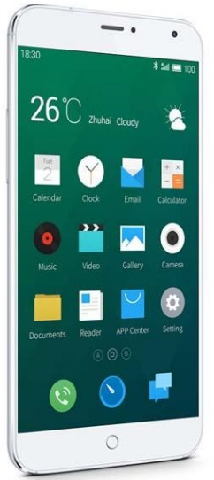
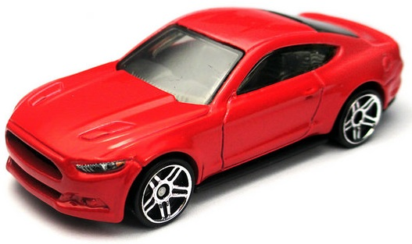
Object Technology
Object technology is a packaging scheme for creating meaningful software units
Almost any noun can be reasonably represented as a software object in terms of
  Properties, and
  Actions
Objects have properties, also called attributes
Objects perform actions, also called behaviors or methods

Slide 46
Object Technology (cont.)
Objects, or more precisely the classes objects come from, are essentially reusable software components
  There are date objects, time objects, audio objects, video objects, automobile objects, people objects, etc.
Using a modular, object-oriented design-and-implementation approach can make software development groups much more productive than was possible with earlier techniques
  Object-oriented programs are often easier to understand, correct and modify
Objects have properties, also called attributes
Objects perform actions, also called behaviors or methods

Slide 47
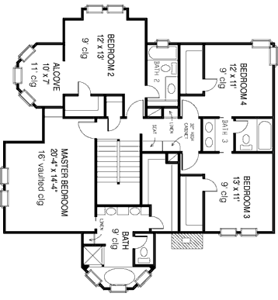

Object Technology (cont.)
Classes are types of related objects
  A class specifies the general format of its objects, and the properties and actions available to an object
  An object is related to its class in much the same way as a building is related to its blueprint
  Properly designed classes can be reused on future projects
  Using libraries of classes reduces the amount of effort required to implement new systems
  Instead of worrying about minute details, you can focus on the behaviors and interactions of objects

Slide 48
Object Technology (cont.)
Methods and Classes
Performing a task in a program requires a method
  A method houses the program statements that actually perform its task
A method hides these statements from its user
  Just as the accelerator pedal of a car hides from the driver the mechanisms of making the car go faster

Slide 49
Object Technology (cont.)
Making Objects from Classes
An object must be built from a class before a program can perform the tasks that the class’s methods define
  Just as someone has to build a car from its engineering drawings before you can actually drive a car
The process of doing this is called instantiation
An object is then referred to as an instance of its class

Slide 50
Object Technology (cont.)
Reuse
A class can be reused many times to build many objects
  Just as a car’s engineering drawings can be reused many times to build many cars
Reuse of existing classes when building new classes and programs saves time and effort
Reuse also helps you build more reliable and effective systems, because existing classes and components often have gone through extensive testing, debugging and performance tuning
  Reusable classes are crucial to the software revolution that has been spurred by object technology

Slide 51
Object Technology (cont.)
Messages and Method Calls
When you drive a car, pressing its gas pedal sends a message to the car to perform a task
  E.g., Go faster
Similarly, you send messages to an object
  Each message is implemented as a method call that tells a method of the object to perform its task

Slide 52
Object Technology (cont.)
Attributes and Instance Variables
An object has attributes that it carries along as it is used in a program
Specified as part of the object’s class
  A bank account object has a balance attribute that represents the amount of money in the account
  Each bank account object knows the balance in the account it represents, but not the balances of the other accounts in the bank
Attributes are specified by the class’s instance variables

Slide 53
Object Technology (cont.)
Encapsulation
Classes encapsulate (i.e., wrap) attributes and methods into objects
  An object’s attributes and operations are intimately related
Objects may communicate with one another, but they are normally not allowed to know how other objects are implemented
  Implementation details are hidden within the objects themselves
Information hiding is crucial to good software engineering

Slide 54
Object Technology (cont.)
Inheritance
A new class of objects can be created quickly and conveniently by inheritance
  The new class absorbs the characteristics of an existing class, possibly customizing them and adding unique characteristics of its own
In our car analogy, an object of class “convertible” certainly is an object of the more general class “automobile”
  More specifically, the roof can be raised or lowered

Slide 55
Object Technology (cont.)
Object-Oriented Analysis and Design (OOAD)
To create the best solutions, you should follow a detailed analysis process for determining your project’s requirements
  i.e., defining what the system is supposed to do
Develop a design that satisfies the requirements
  i.e., deciding how the system should do it
Carefully review the design (and have your design reviewed by other software professionals) before writing any code

Slide 56
Object Technology (cont.)
Object-Oriented Analysis and Design (OOAD)
If this process involves analyzing and designing your system from an object-oriented point of view, it is called an object-oriented analysis and design (OOAD) process
Object-oriented programming (OOP) allows you to implement an object-oriented design as a working system

